Slide 1

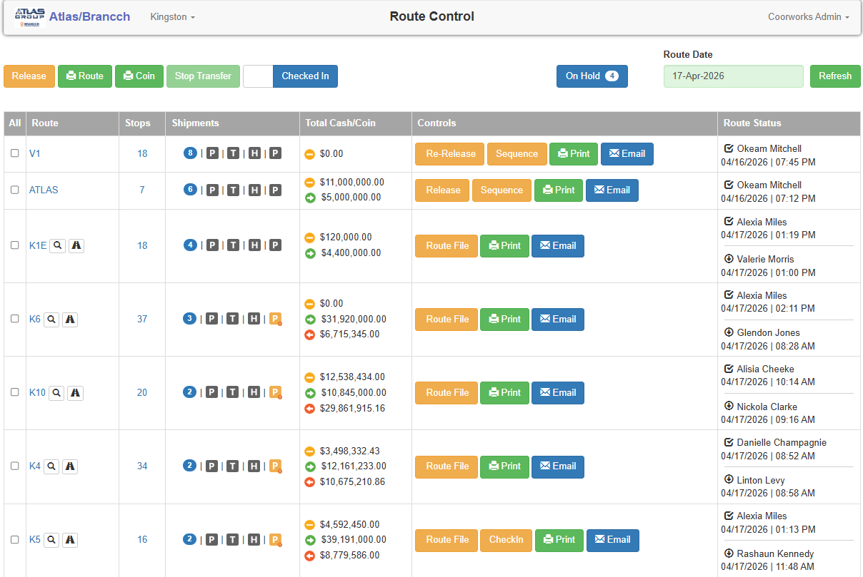
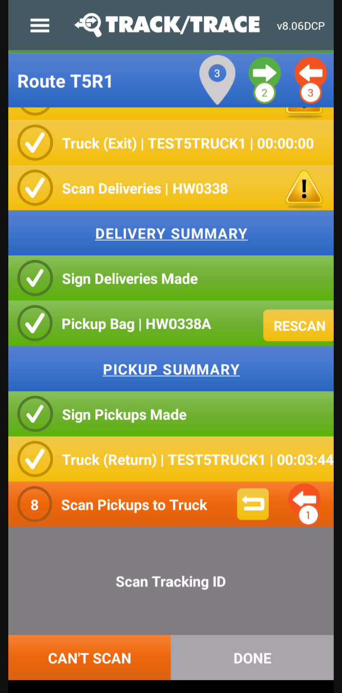
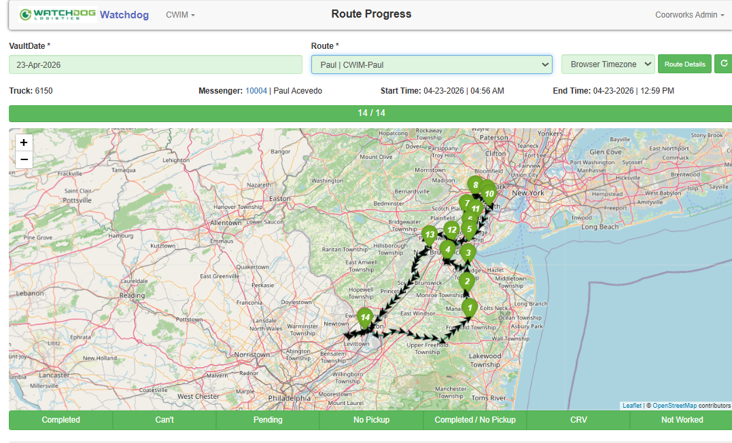
Capabilities | Benefit Targets | Deployment Cases | Customers | ATMS | Integrations | Process
ONE PLATFORM | INFINITE EXPANSION
Contact
Everything CIT/ATM/FLM in 1 Relationship
CURRENCY PLATFORMS
BLUETOOTH DEVICES
CASH SORTERS
BANK/FI PLATFORMS
ENTERPRISE SYSTEMS
INTEGRATIONS

Slide 2
Key Capability Foundations | The Pillars of Operational Consistency, Efficiency, Automation
Evolve Your CIT/ATM/FLM Business Anyway YOU Want
CENTRALIZED MGMT
ACTION PERMISSIONS
OPERATION DESIGN
PROCEDURE DESIGN
SECURED TRANSFER
REAL-TIME CASH VISIBILITY
PACK/COUNT/DEPOSIT
CUSTOMIZABLE LEDGERS
BANK/FI ORDER MGMT
FULLY AUDTIABLE
DIRECT OPS PARTICPATION
REAL-TIME VISIBILITY
LIVE PICKUP REQUESTS
EVENT NOTIFICATIONS
RECEIPTS/MANIFESTS
BILLING COORDINATION
EVENT -> BILLING RULES
SERVICE COORDINATION
CHANGE MGMT
DOCUMENT MGMT
DYNAMICALLY ROUTABLE
RECURRING SCHEDULES
SHIP TYPE ROUTING MGMT
EMPTY/FILL FORECASTING
KABA/S&G INTEGRATED
BRANCHES
CASH VAULTS
CUSTOMERS
CONTRACTS
LOCATIONS
FORECAST CREATABLE
AUTO-CREATE SCHEDULES
RECEIPT/POD CAPTURE
ON-ROUTE DELIVERABLE
DELIVERY CUTOFFS
REAL-TIME TRACKING
DYNAMIC & AUTO REROUTING
DRIVE OPTIMIZATION
ETA TIME/MILEAGE
LIABILITY ENFORCED
SEQUENCED VS. ACTUAL
LIVE ROUTE TRANSFER
PER STOP OPTIMIZATION
ETA MANAGEMENT
TRUCK TRANSFERS
WORKFLOW-CONTROLLED
STOP/STEP ENFORCED
REAL-TIME WORK UPDATES
JUST-IN-TIME OPEN CODES
DEVIATION ALERT/APPROVE
LIABILITY ENFORCEMENT
FIXED ROUTE ASSIGNMENT
CAGE/SAFE INTEGRATION
TRUCK PRE-TRIP CHECKS
GEO-FENCED ACCESS
SHIPMENTS
ROUTES
STOPS
FIELD USERS
TRUCKS
SERVICE MONITORING
SAME-DAY DELIVERIES
BATCH PROCESSING
COIN + COIN MANAGEMENT
DELIVERY/COUNT CONTROLS
ORDER TYPE WORKFLOWS
SAME-DAY DECASH/RECASH
AUTOMATED LOCK DISPATCH
REQUIRED DEPOSITS
SERVICE CHECKLISTS
CUSTOMIZABLE MODEL
AUTO-TICKET ASSIGNMENT
EXTERNAL COORDINATION
CUSTOMER PORTAL
ON-ROUTE ASSIGNMENTS
REAL-TIME EVENT BILLING
ALL SERVICES APPLICABLE
MISSED BILLABLE EVENTS
CUSTOMER ACCESSIBLE
SYSTEM EXPORTABLE
TOP PERFORMERS
ROUTE/STOP TIMING
UTILIZATION TRENDING
SERVICE REPONSIVENESS
FIELD/VAULT COMPLIANCE
CIT/FI
RETAIL/FI ATM
FLM/SLM
BILLING
ANALYTICS

Slide 3

Main Benefit Targets | Next Foundations to Optimize Your Operation
> 90 Day Implementation Targets
Dynamic & Automated Routing Operations
UI Simplification & User Proofing
Full Auditability of All User/Shipment Events
Real-Time Deviation Detection/Approval
Precision User Permissions Controls
Deal with Any Edge Case
Order Workflow Enforcement Design
Integrated Customer Engagement
Automate any Service Schedule
Billing on Any Service Action

Slide 4
Customer Integration | Strengthen Loyalty and Maximize Efficiency
Win Them Once Service Them Forever
Location
Service History
Shipment
Specific
History
Ledger
Activity
Daily Vault Balance
View/Adjust
Cash/Coin Schedules
On-Demand
Shipment
Create/Edit
Routed/Ad-Hoc
Pickup
Requests
Delivery
Pickup
Receipts
Signature
Receipt
Capture
Bank/Carrier
POD
Real-Time
Billing
Service
Ticket
Requests
ETA
Notifications
Location
Change Mgmt
Operating
Hours

Slide 5
Deployment Case | Regional CIT – Increasing Operational Scaling
With No Extra Time for Anything - Need a Co-Managed Platform Configured for Maximum Process Efficiency
~
Key Functional Foundations
Simplified Regular/Emergency Ledgering
User-Proof Order Create, Packing Counting
Daily Vault Balance & Activity Reporting
Deposit Out/Bag Out Packing
Dynamically Routed Fed/Bank Pickups
Real-Time Billing & One-Off Charges
Automation-Assisted Route Planning
Customer Pickup Request Management
Coin Management & ITM Coin Capabilities
Scope
5 Daily Routes
10-20 Stops/Route/Day
3-5 Dedicated Ops Staff/Mgmt
Key Platform Targets
Expand Customer Base
Simplify Resource Expansion
Increase Route/Stop Ratios
Deepen Customer Engagement
Structured Billing Established

Slide 6
Deployment Case | ATM Loading & FLM Service
With No Time to Breath Day Over Day – Need a System to Automate Key Logistical Functions
~
Key Functional Foundations
Regular/Emergency Ledgers
Daily Vault Balance & Activity Reporting
Deposit Out/Bag Out Packing
Dispense Forecasting & Automated Shipment Creation
Dynamically Routed Fed/Bank Pickups
Fully Automated Lock Dispatch
Real-Time Cross-Service Billing
Scope
5 Daily Routes
10-20 Stops/Route/Day
3-5 Dedicated Ops Staff/Mgmt

Slide 7
Deployment Case | High Volume CIT Operation
With No Time to Breath Day Over Day – Need a System to Fully Trust Operational Enforcement
~
Key Functional Foundations
Precision User Permissions
Scope
5 Daily Routes
10-20 Stops/Route/Day
3-5 Dedicated Ops Staff/Mgmt
Key Platform Targets
Full Auditability Established
Zero-Trust Enforcement

Slide 8
Deployment Case | FLM Service Provider Operation
No More Non-Industry Specific, Generic One-Sized Fits All Service Management Platforms
~
Key Functional Foundations
Customizable Service Options & Controls
Enforced Compliance per Service Action
Pic/Video Evidence Capture (before/after)
Direct Customer Participation (Create/Cancel)
Machine Service and Truck Checklists
Automated Lock Opening/Closing
Service-Level Agreement Visibility
Simplified Parts Management
ETA Notification Capabilities
Item/Tool/Equipment Checkin/Checkout
Technician Auto Assignment Rules
Preventative Maintenance Schedules
Scope
10+ Service Technicians
Key Platform Targets
Custom Configured Model
Deepen Customer Engagement
Integrate Lock Operations

Slide 9


Lock Automation | Securely Fully Automate Routine Dispatching
Kaba
OTC Anywhere
Geofenced Open Controls
Close Enforcement
Automated Reassigns
Truck Cages/Safes
S&G
Integard

Slide 10
Integrations | Expansive Integration Capabilities
We Work On-Demand Too
Currency
Platforms
Bank/FI
Systems
Cash
Sorters/Safes
Bluetooth
Devices
Core
Processes
External
Solutions
Shipment Import
Status Updates
Location Detail
Adaptive I/O Framework
Cash/Coin Ordering
Vault Balance/Activity
Approved Shipments
Order Timing Controls
Deposit Out Procedures
Regular/EC Ledgering
Data Directly Accessible
Semacon
Glory
Recommend
HID Laser Scanners
Printers
Recommend
Shipment Batch Create
Shipment File Import
Machine Balances
Change Management
User Time Exports
Billing Exports
Invoicing AP/AR
API –Based
SFTP Transfer

Slide 11
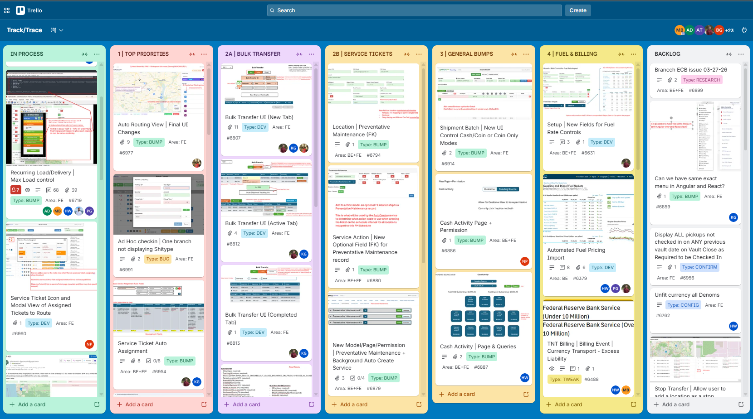
Process | Direct Platform Management
You Help Drive and Direct Weekly Platform Updates

Slide 12
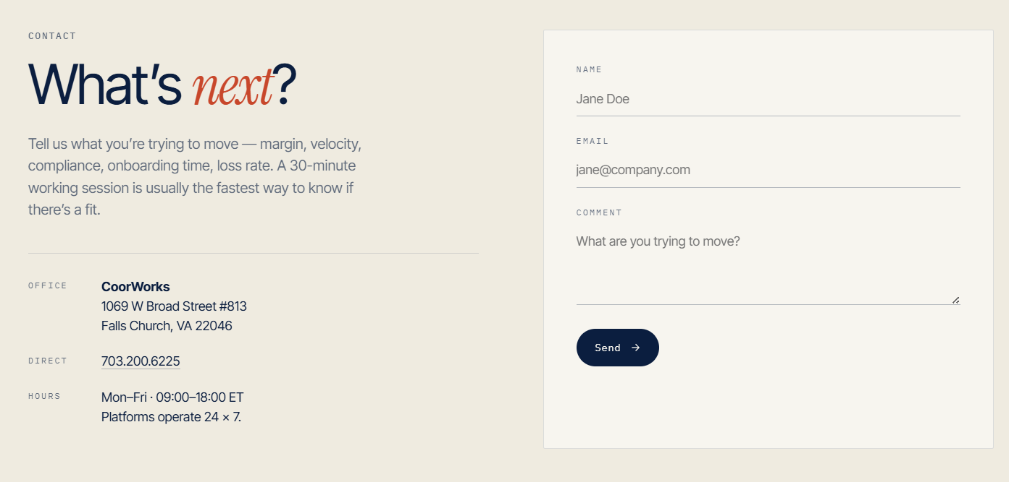
Schedule A Demo
Schedule an hour to understand the scope
of TNT and where it can move the needle in
your CIT/ATM/FLM service operation.
Tell us about your operation…
Support@Coorworks.com

Slide 13
{Do Not Include Past this point}

Slide 14

ONE PLATFORM | INFINITE EXPANSION
Evolve Your CIT/ATM/FLM Business Anyway YOU Want
CENTRALIZED MGMT
ACTION PERMISSIONS
OPERATION DESIGN
PROCEDURE DESIGN
SECURED TRANSFER
REAL-TIME CASH VISIBILITY
PACK/COUNT/DEPOSIT
CUSTOMIZABLE LEDGERS
BANK/FI ORDER MGMT
FULLY AUDTIABLE
DIRECT OPS PARTICPATION
REAL-TIME VISIBILITY
LIVE PICKUP REQUESTS
EVENT NOTIFICATIONS
RECEIPTS/MANIFESTS
BILLING COORDINATION
EVENT -> BILLING RULES
SERVICE COORDINATION
CHANGE MGMT
DOCUMENT MGMT
DYNAMICALLY ROUTABLE
RECURRING SCHEDULES
SHIP TYPE ROUTING MGMT
EMPTY/FILL FORECASTING
KABA/S&G INTEGRATED
BRANCHES
CASH VAULTS
CUSTOMERS
CONTRACTS
LOCATIONS
FORECAST CREATABLE
AUTO-CREATE SCHEDULES
RECEIPT/POD CAPTURE
ON-ROUTE DELIVERABLE
DELIVERY CUTOFFS
REAL-TIME TRACKING
DYNAMIC & AUTO REROUTING
DRIVE OPTIMIZATION
ETA TIME/MILEAGE
LIABILITY ENFORCED
SEQUENCED VS. ACTUAL
LIVE ROUTE TRANSFER
PER STOP OPTIMIZATION
ETA MANAGEMENT
TRUCK TRANSFERS
WORKFLOW-CONTROLLED
STOP/STEP ENFORCED
REAL-TIME WORK UPDATES
JUST-IN-TIME OPEN CODES
PERIPHERALS (PRINT/SCAN)
LIABILITY ENFORCEMENT
FIXED ROUTE ASSIGNMENT
CAGE/SAFE INTEGRATION
TRUCK PRE-TRIP CHECKS
GEO-FENCED ACCESS
SHIPMENTS
ROUTES
STOPS
FIELD USERS
TRUCKS
SERVICE MONITORING
SAME-DAY DELIVERIES
BATCH PROCESSING
COIN + COIN MANAGEMENT
DELIVERY/COUNT CONTROLS
ORDER TYPE WORKFLOWS
SAME-DAY DECASH/RECASH
AUTOMATED LOCK DISPATCH
REQUIRED DEPOSITS
SERVICE CHECKLISTS
CUSTOMIZABLE MODEL
AUTO-TICKET ASSIGNMENT
EXTERNAL COORDINATION
CUSTOMER PORTAL
ON-ROUTE ASSIGNMENTS
REAL-TIME EVENT BILLING
ALL SERVICES APPLICABLE
MISSED BILLABLE EVENTS
CUSTOMER ACCESSIBLE
SYSTEM EXPORTABLE
TOP PERFORMERS
ROUTE/STOP TIMING
UTILIZATION TRENDING
SERVICE REPONSIVENESS
FIELD/VAULT COMPLIANCE
CIT/FI
RETAIL/FI ATM
FLM/SLM
BILLING
ANALYTICS
CURRENCY PLATFORMS
BLUETOOTH DEVICES
CASH SORTERS
BANK/FI PLATFORMS
ENTERPRISE SYSTEMS
INTEGRATIONS

Slide 15
ONE PLATFORM | INFINITE EXPANSION
Evolve Your CIT/ATM/FLM Business Anyway YOU Want
CENTRALIZED MGMT
ACTION PERMISSIONS
OPERATION DESIGN
PROCEDURE DESIGN
SECURED TRANSFER
REAL-TIME CASH
PACK/COUNT/DEPOSIT
CUSTOMIZABLE LEDGERS
BANK/FI ORDER MGMT
FULLY AUDTIABLE
REAL-TIME VISIBILITY
OPS PARTICPATION
LIVE PICKUP REQUESTS
EVENT NOTIFICATIONS
RECEIPTS/MANIFESTS
BILLING COORDINATION
EVENT -> BILLING RULES
SERVICE COORDINATION
CHANGE MGMT
DOCUMENT MGMT
DYNAMICALLY ROUTABLE
RECURRING SCHEDULES
SHIP TYPE ROUTING MGMT
EMPTY/FILL FORECASTING
KABA/S&G INTEGRATED
FORECAST CREATED
AUTO-CREATE SCHEDULES
RECEIPT/POD CAPTURE
ON-ROUTE DELIVERABLE
DELIVERY CUTOFFS
REAL-TIME TRACKING
DYNAMIC MGMT
DRIVE OPTIMIZATION
ETA TIME/MILEAGE
LIABILITY ENFORCED
SEQUENCED VS. ACTUAL
LIVE ROUTE TRANSFER
PER STOP OPTIMIZATION
ETA MANAGEMENT
TRUCK TRANSFERS
BRANCHES
CASH VAULTS
CUSTOMERS
CONTRACTS
LOCATIONS
SHIPMENTS
ROUTES
STOPS
WORKFLOW-CONTROLS
STOP/STEP ENFORCED
STOP OPTIMIZATION
DYNAMIC UPDATING
PERIPHERALS
LIABILITY ENFORCEMENT
FIXED ROUTE ASSIGN
CAGE/SAFE INTEGRATION
GEO-FENCED ACCESS
NFC TAGGABLE
SERVICE MONITORING
ON-ROUTE DELIVERY
BATCH PROCESSING
COIN + COIN MANAGEMENT
DELIVER/COUNT CONTROLS
ORDER TYPE WORKFLOWS
SAME DAY DECASH/RECASH
AUTO LOCK DISPATCH
REQUIRED DEPOSITS
SERVICE CHECKLISTS
CUSTOMIZABLE MODEL
AUTO TICKET ASSIGN
EXTERNAL COORDINATION
CUSTOMER CREATION
ROUTE ASSIGNMENTS
REAL-TIME EVENT BILLING
ANY SERVICE CAPABLE
MISSED BILLABLE EVENTS
CUSTOMER SHARABLE
EXPORTABLE
TOP PERFORMERS
ROUTE/STOP TIMING
UTILIZATION TRENDING
SERVICE REPONSE
FIELD/VAULT COMPLIANCE
CURRENCY PLATFORMS
BLUETOOTH DEVICES
CASH SORTERS
BANK/FI PLATFORMS
ENTERPRISE SYSTEMS
FIELD USERS
TRUCKS
CIT/FI DEPOSITS
RETAIL/FI ATM ORDERS
SERVICE FLM/SLM
BILLING
ANALYTICS
INTEGRATIONS

Slide 16
ONE PLATFORM | INFINITE EXPANSION
Evolve Your CIT/ATM/FLM Business Anyway YOU Want
CENTRALIZED
MANAGEMENT
BANK/FI
ORDERING
REAL-TIME
PICKUP REQUESTS
NOTIFICATIONS
RECEIPTS
MANIFESTS
REAL TIME
BILLING
STATIC
RECURRING
DYNAMIC
ROUTING
FORECAST/
AUTO CREATE
ORDER-BASED
WORKFLOWS
AUTO ROUTING
AUTO OPTIMIZE
ETA TRACKING
CAGES/SAFES
USER
PERMISSIONS
PERIPHERALS
REAL-TIME
TRACKING
AUTO LOCK
DISPATCH
AUTO TICKET
DISPATCH
BRANCHES
CASH VAULTS
CUSTOMERS
CONTRACTS
LOCATIONS
SHIPMENTS
STOPS
ROUTES
TRUCKS
FIELD USERS
CIT/FI
DEPOSITS
RETAIL/FI
ATM
SERVICE
FLM/SLM
CUSTODY CONTROLS | OPERATIONS + LIABILITY ENFORCEMENTS | COMPLETE AUDIT TRAILS
REPORTING/ANALYTICS
INTEGRATIONS
CONTINUTAL EVOLUTION | ITERATIVE OPTIMIZATION | MAXIMUM ROI

